Slide 1
Group 1: Presentation 1
James Pyke
Matthew Lummis
Benjamin Attebery
Kenneth Pirkle

Slide 2
Logline
Players compete to control territories whilst avoiding enemy fire.

Slide 3
Genre
Target Audience
Artillery / Territory Control Game for 2-4 players
Predominantly males: 16-25
Hard fun and People Fun - Strategy and Goals as well as Social bonding and competition.
http://quanticfoundry.com/2015/09/04/game-audience-profiles/

Slide 4
Objective
First team to a reach a certain amount of points wins
Points are accumulated over time by the Player Character capturing specific zones
King of the Hill

Slide 5
Main Mechanic
Shooting Explosive Projectiles
Newtonian physics
Recoil

Slide 6
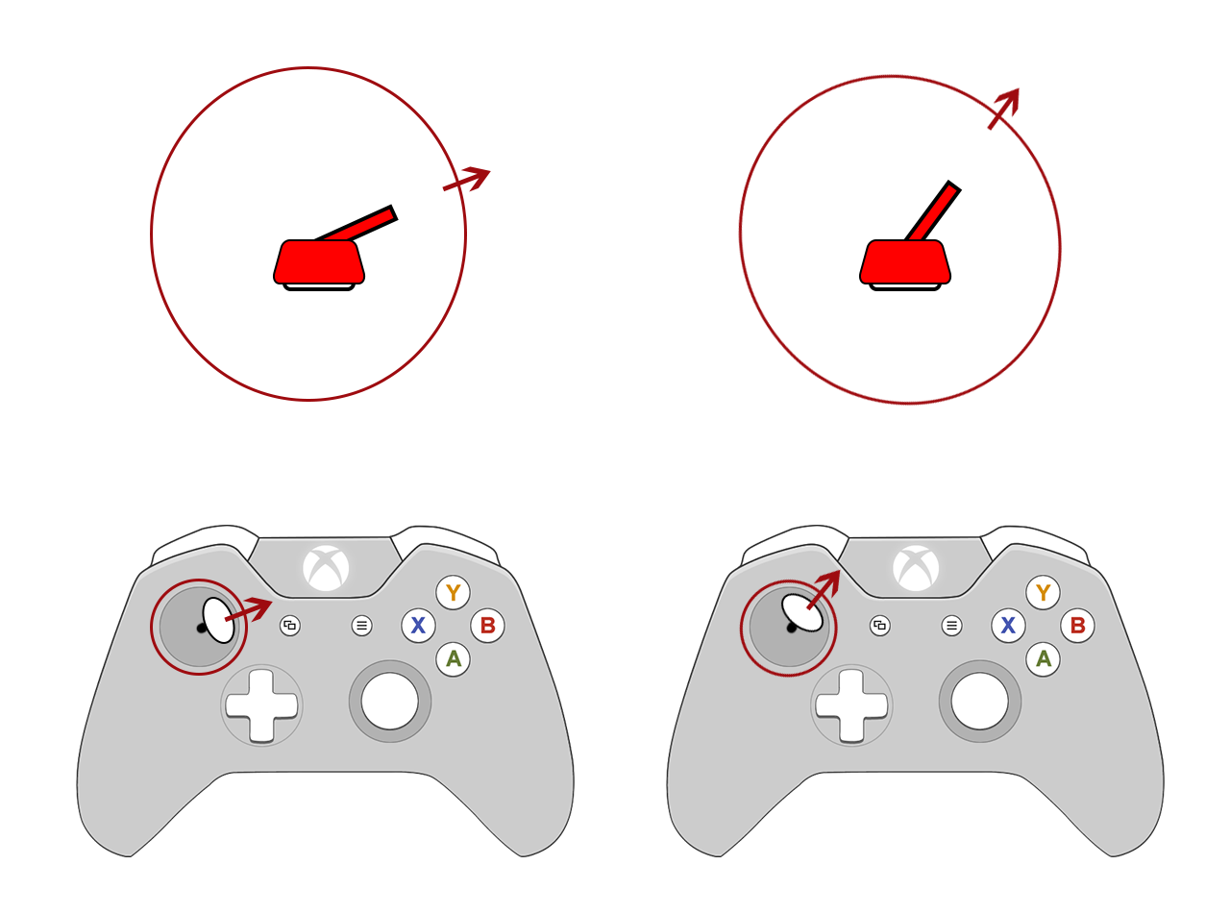
Main Mechanic
Direction

Slide 7
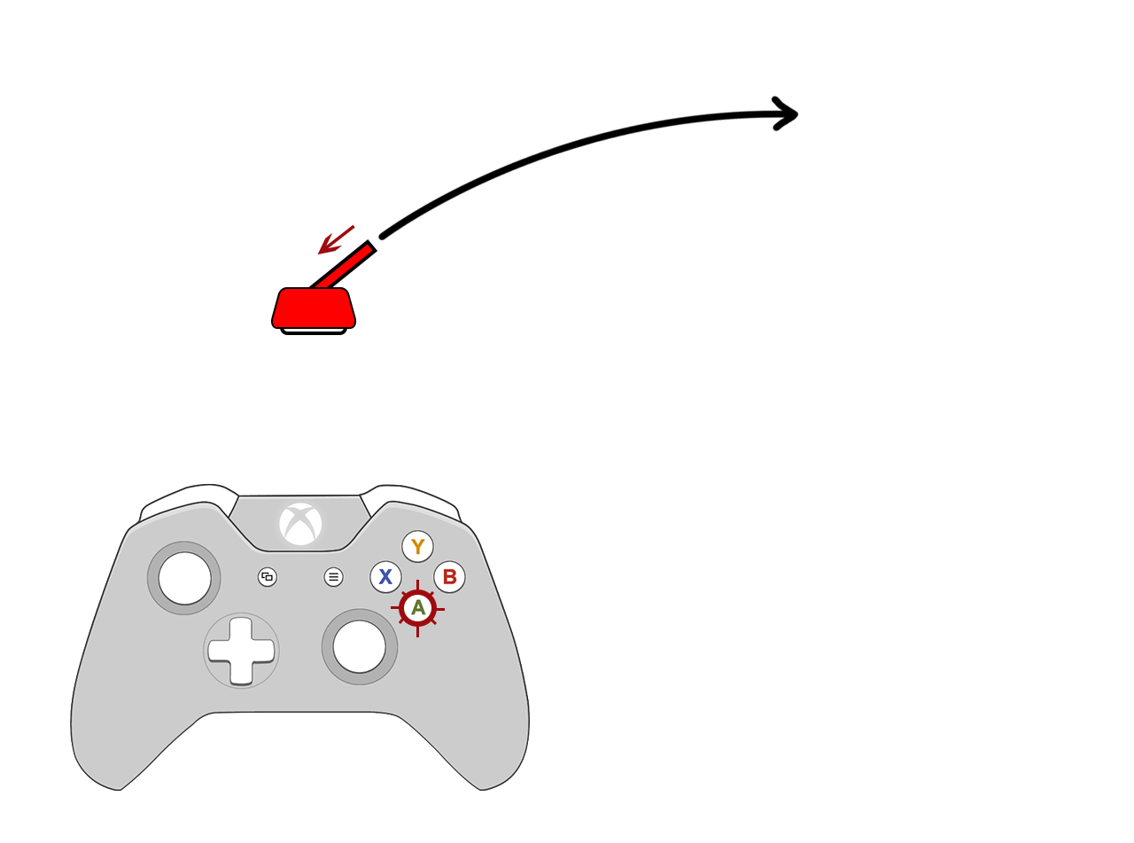
Main Mechanic
Strength

Slide 8
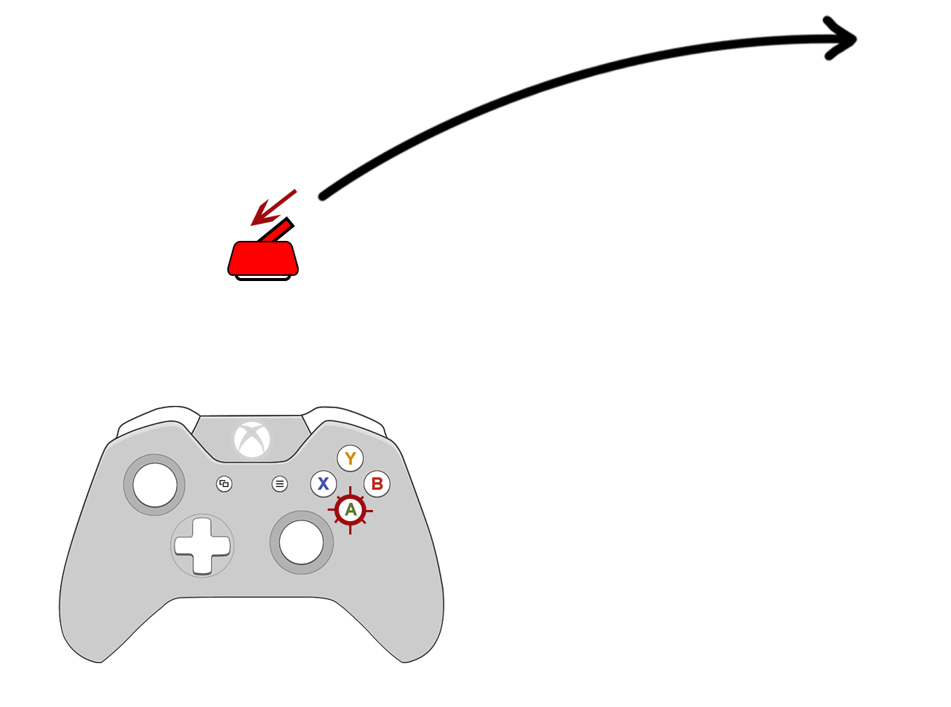
Main Mechanic
Strength

Slide 9
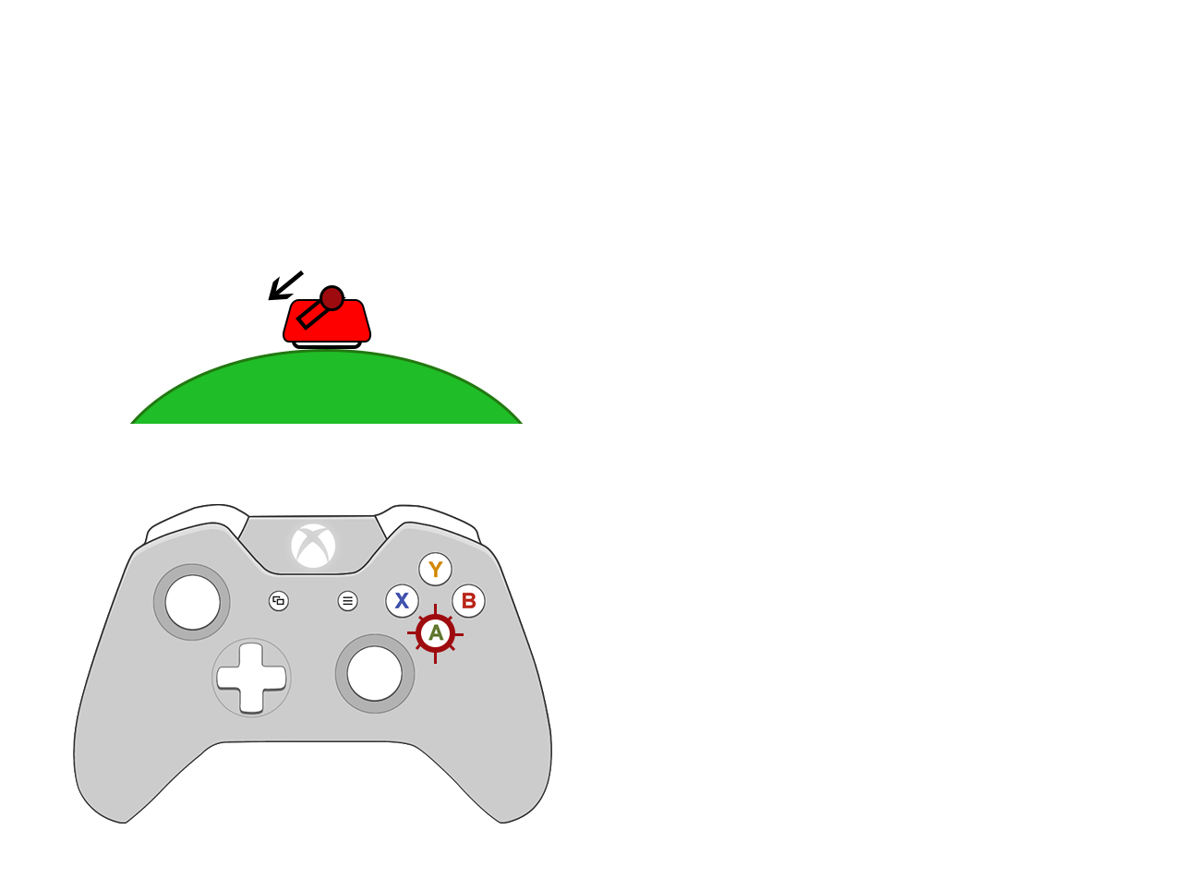
Main Mechanic
Recoil

Slide 10
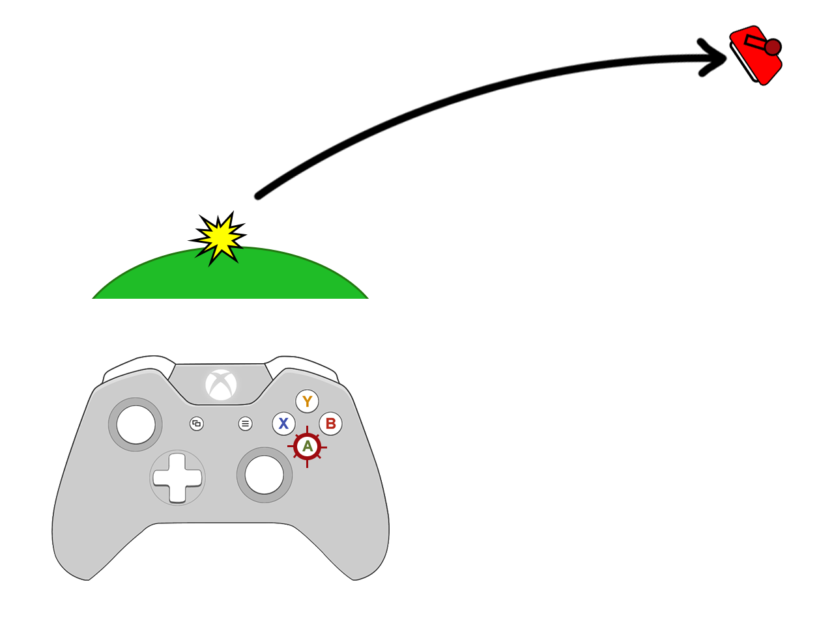
Main Mechanic
Recoil

Slide 11
Level Design / Art Style
2D side view
Single screen arena

Slide 12

Background Artstyle

Slide 13
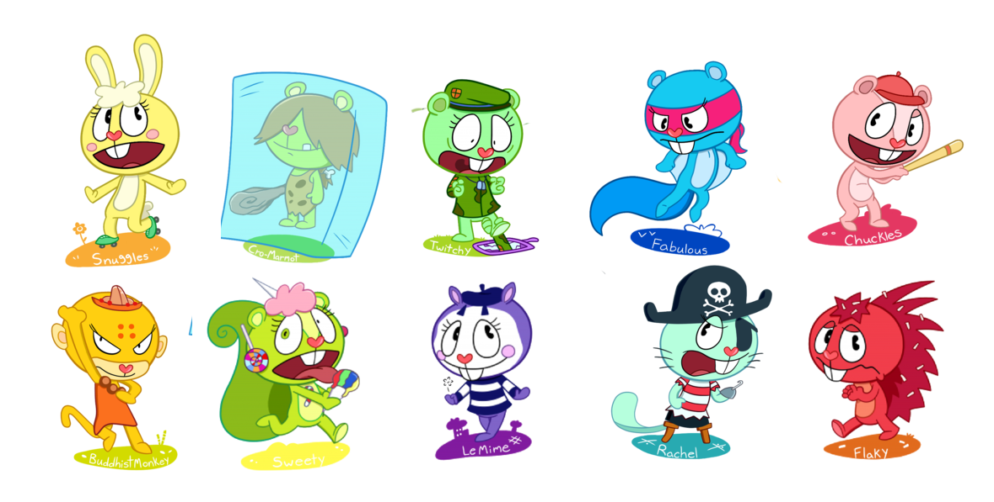
Character Design Ideas

Slide 14
Any Questions?

Slide 15
Main Mechanic and Objective
Gravity Free falling and wind resistance
Disrupting other players to reach the ground first
Single Screen battle
Multiple game modes e.g. hang time or simply freefall

Slide 16
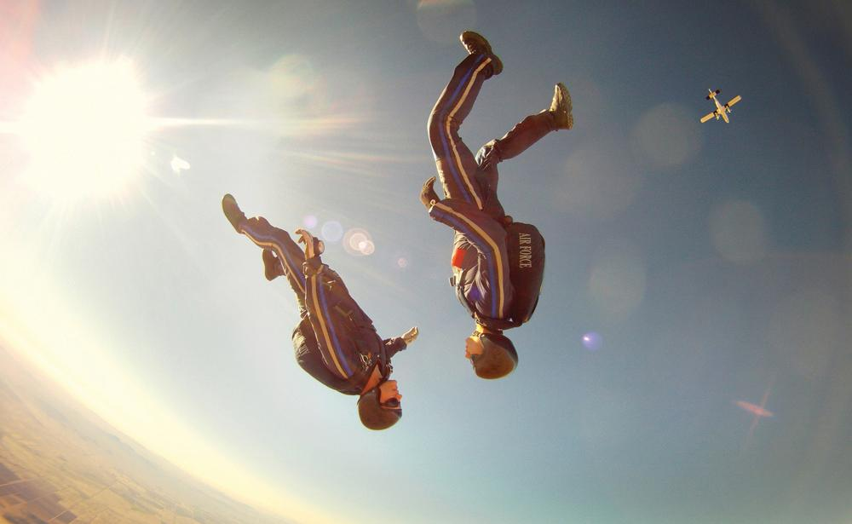

Freefall

Slide 17


Background Ideas

Slide 18
Any further questions?

